Slide 1
Technologies and Costs
Rajiv Sethi and the CORE Team
September 22, 2020

Slide 2
Overview
Inputs and outputs
Dominated technologies
Input costs and technology
Responses to changes in input prices
Understanding the industrial revolution
Reading: The Economy Unit 2 Introduction and 2.1-2.6

Slide 3
Technologies

Slide 4
Technologies
A technology is a process for transforming inputs into outputs
Example: seeds, farm equipment, water, fertilizer, labor into crops
Inputs cost money, outputs sell at a price
In choosing among technologies, input prices are a critical concern
Firms will try to economize on expensive inputs
A dominated technology needs more of all inputs for given output
Compared with some other technology
Dominated technologies will be avoided regardless of input prices

Slide 5
Example
Five technologies use labor and energy to produce a given amount of cloth
Technology
Number of Workers
Tons of Coal
A | 1 | 6
B | 4 | 2
C | 3 | 7
D | 5 | 5
E | 10 | 1

Slide 6
Example (continued)
Five technologies use labor and energy to produce given amount of cloth
Some are labor-intensive and some resource-intensive
Those that use more of each input are dominated
Dominated technologies will not be used regardless of input prices
Which technologies are dominated?
Among undominated technologies, choice depends on input costs

Slide 7
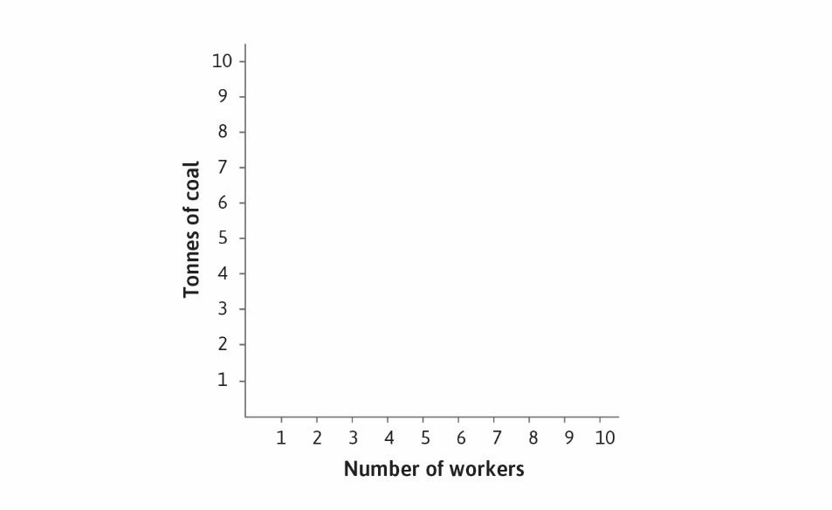

Slide 8
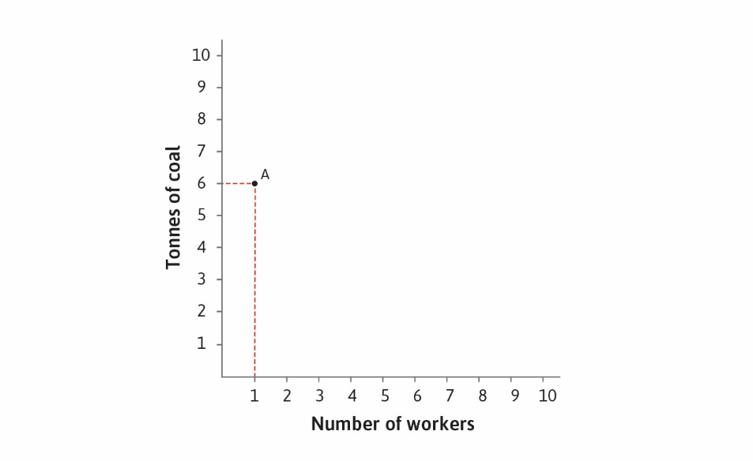

Slide 9
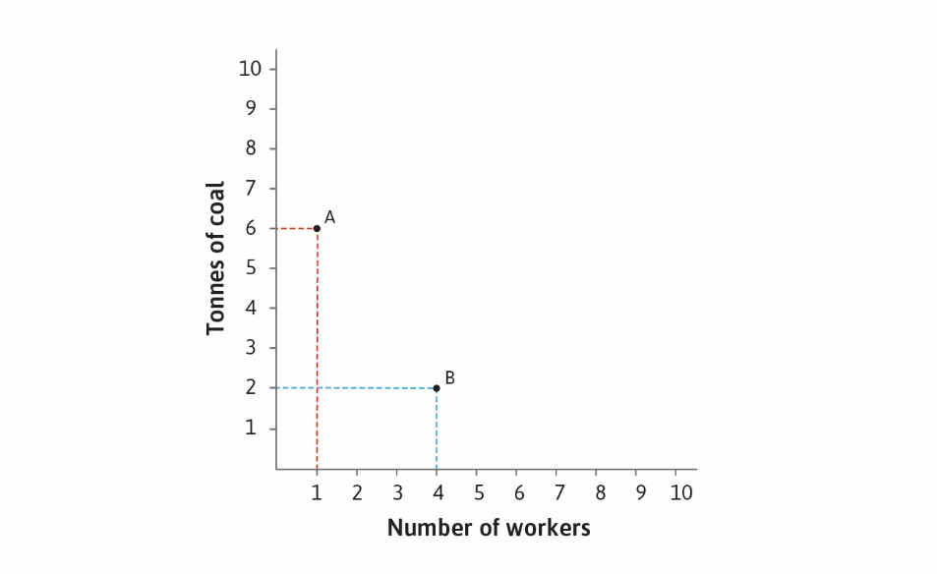

Slide 10
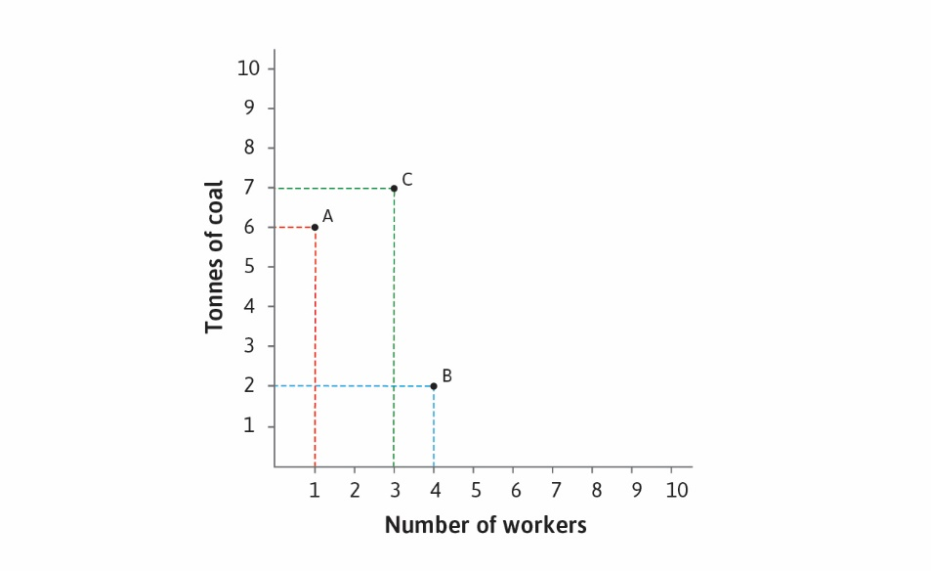

Slide 11
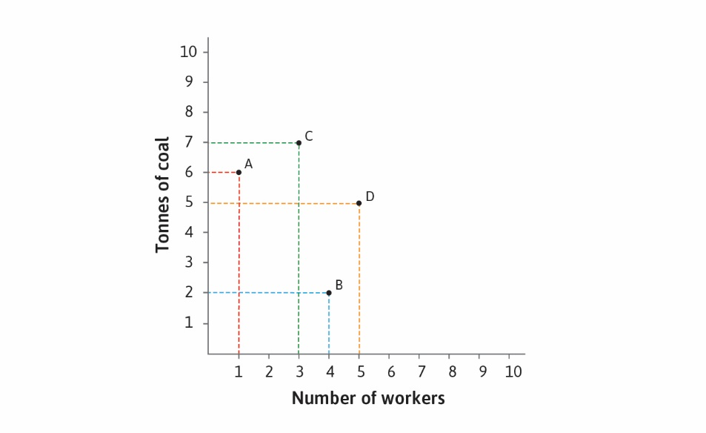

Slide 12
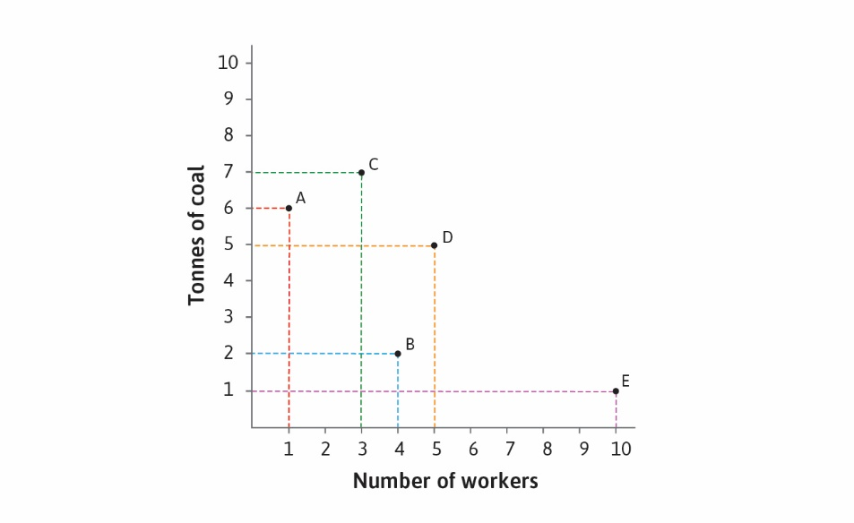

Slide 13
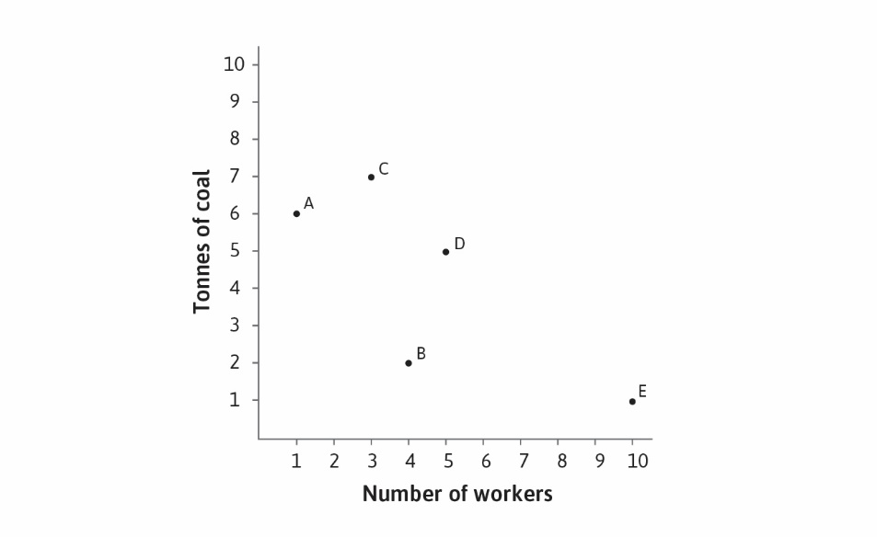

Slide 14
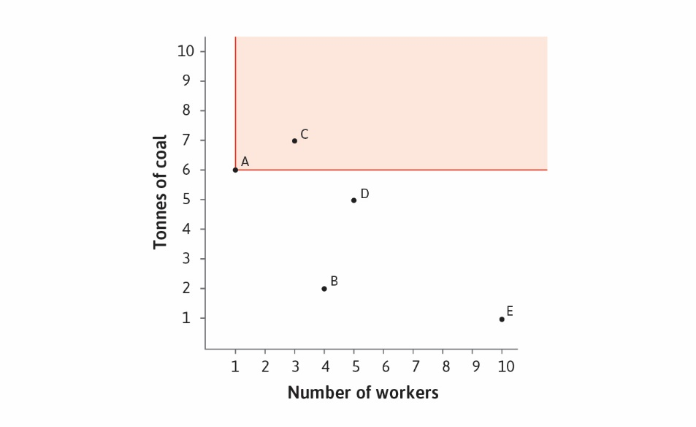

Slide 15
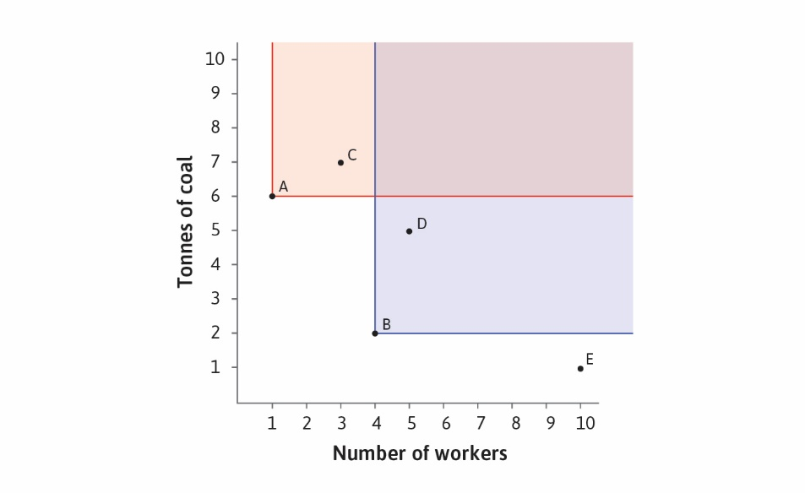

Slide 16
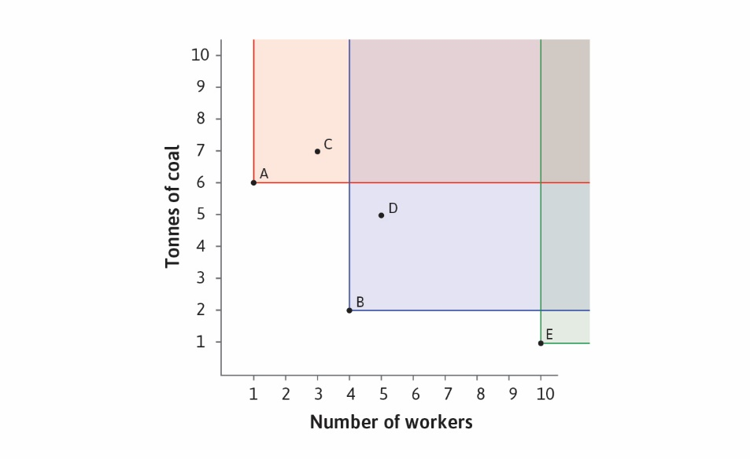

Slide 17
Costs of Production

Slide 18
Costs of Production
How do we choose among undominated technologies?
Depends on input prices
Given a budget, we can draw line through affordable input combinations
These are all input combinations that cost the same to purchase
The line through these points is called an isocost line
Above this line are more expensive input combinations
Below the line are cheaper combinations
Isocost lines for different budgets are parallel
Suppose wage rate is 10 and coal price is 20, what can we buy for 80?

Slide 19
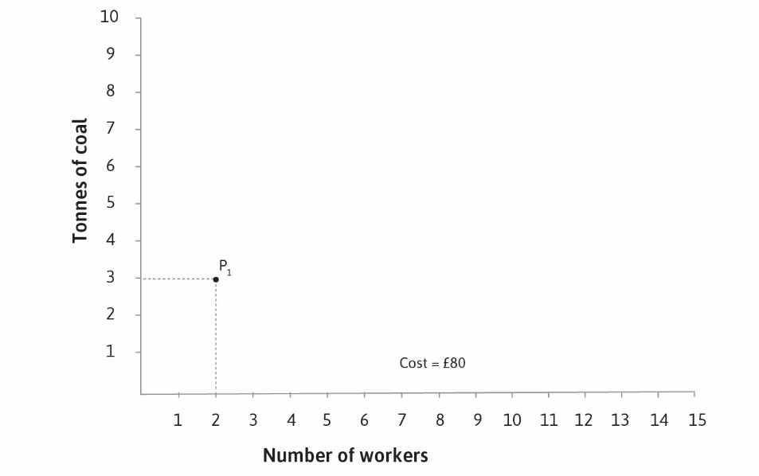

Slide 20
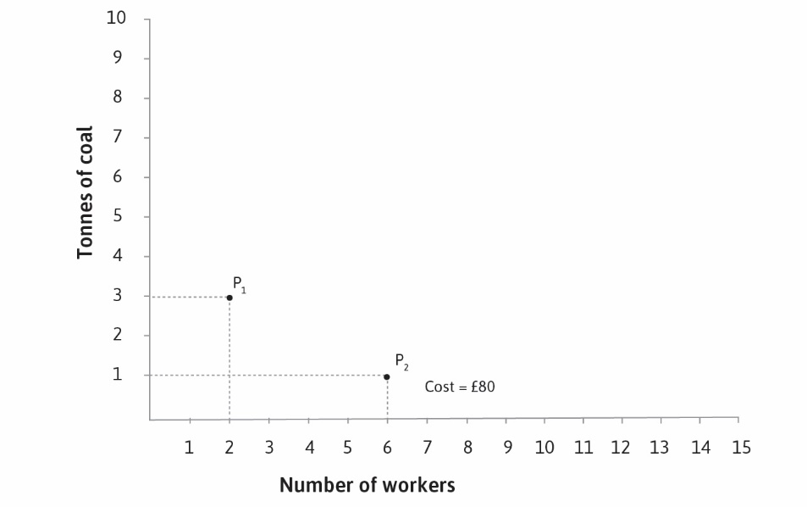

Slide 21
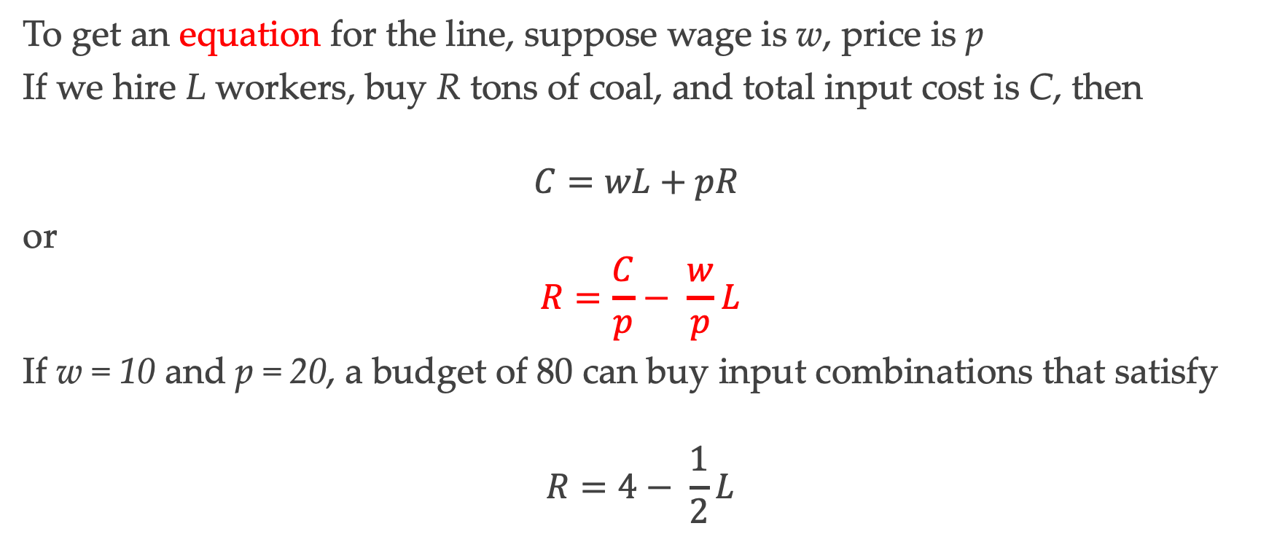
Isocost Lines
To get an equation for the line, suppose wage is w, price is p
If we hire L workers, buy R tons of coal, and total input cost is C, then
$$C=wL+pR$$
or
$$R=\frac{C}{p}− \frac{w}{p}L$$
If w = 10 and p = 20, a budget of 80 can buy input combinations that satisfy
$$R=4− \frac{1}{2}L$$

Slide 22
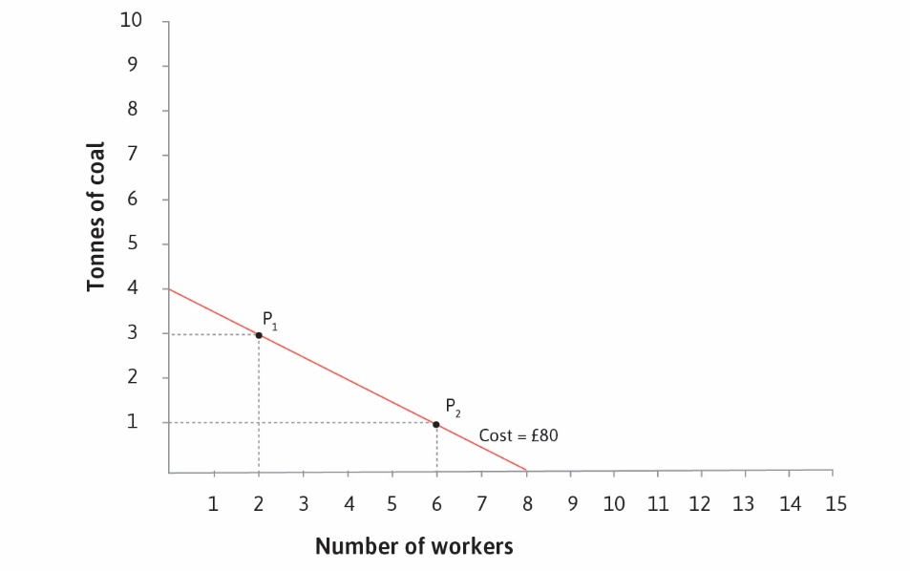

Slide 23
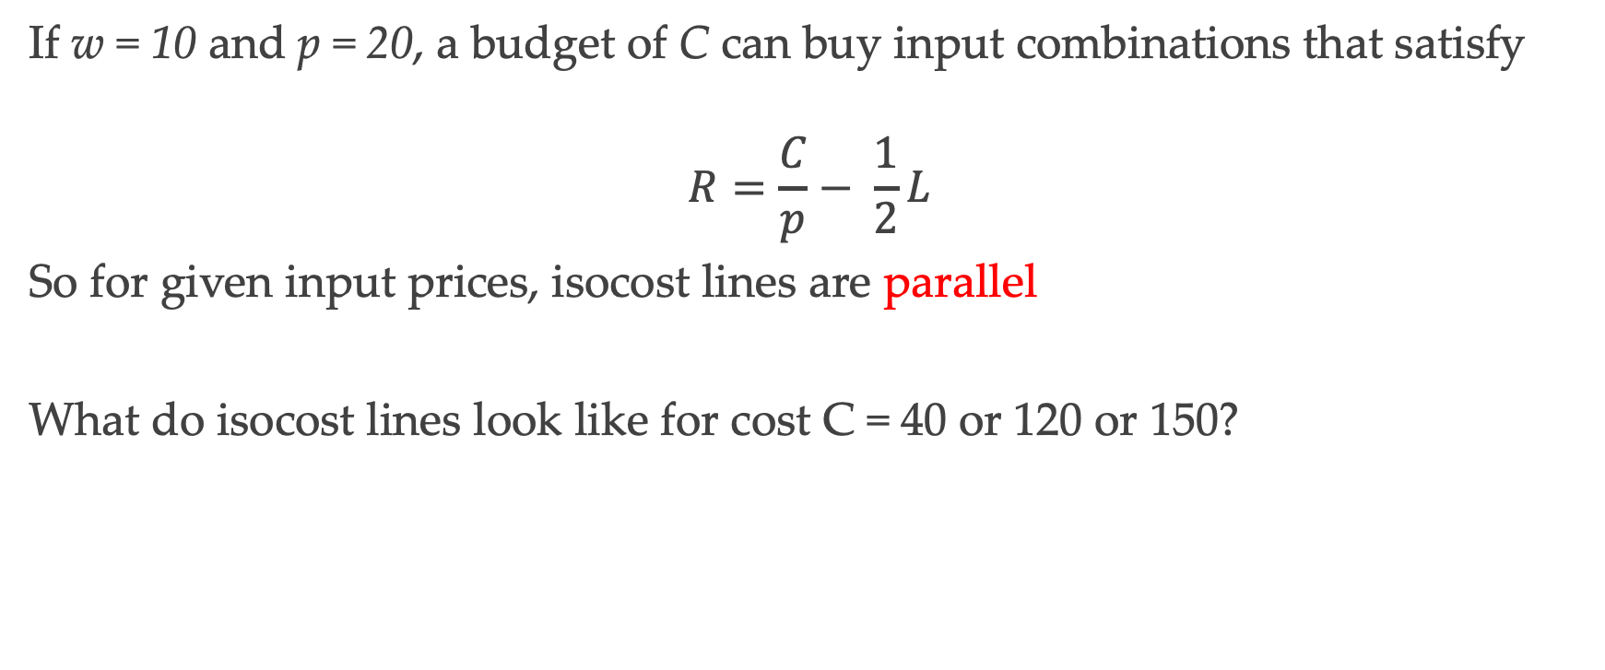
Isocost Lines
If w = 10 and p = 20, a budget of C can buy input combinations that satisfy
$$R=\frac{C}{p}− \frac{1}{2}L$$
So for given input prices, isocost lines are parallel
What do isocost lines look like for cost C = 40 or 120 or 150?

Slide 24
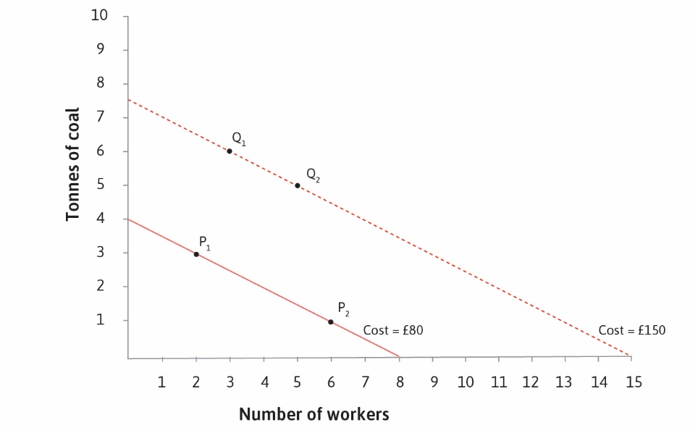

Slide 25
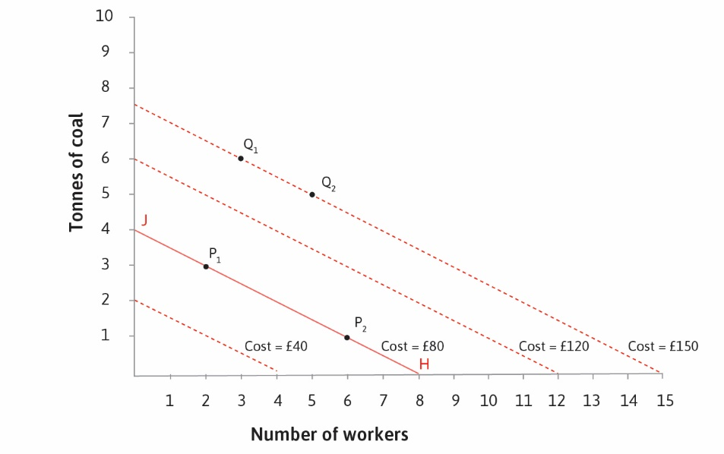

Slide 26
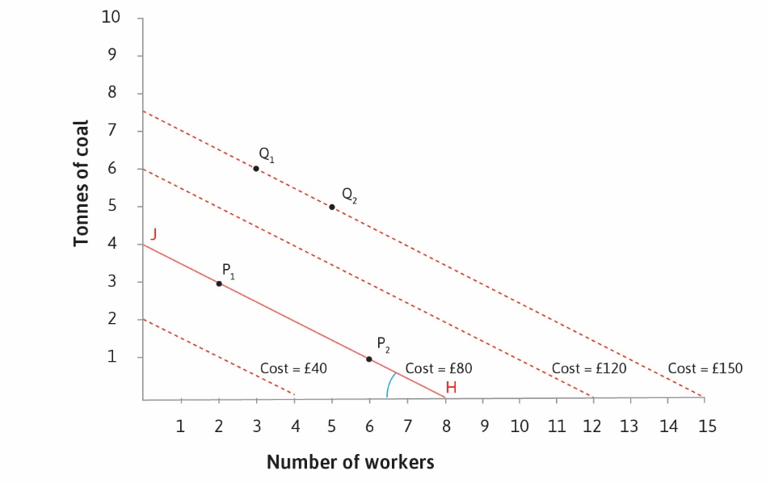

Slide 27
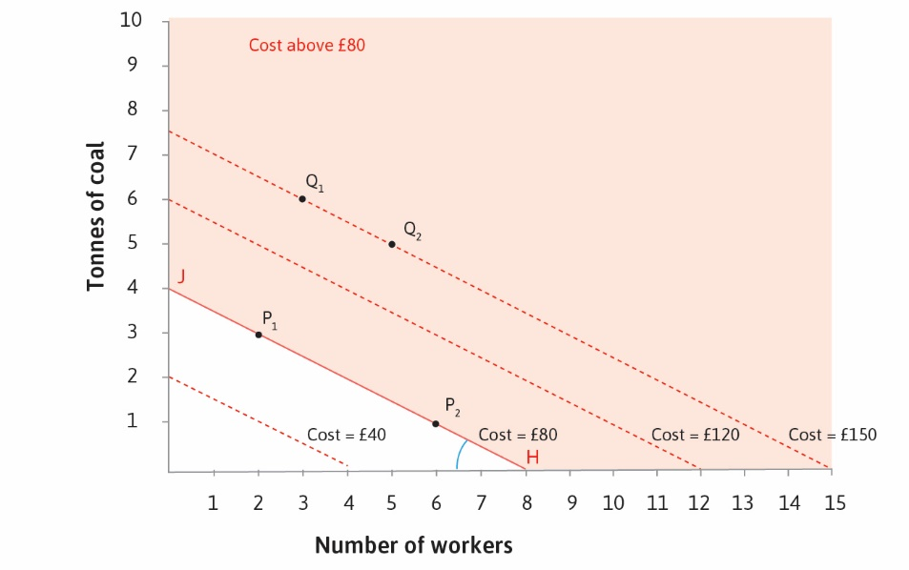

Slide 28
Technology Choice

Slide 29
Technology Choice
Given set of technologies and input prices, which to choose?
For example: if w = 10 and p = 20, which technology is best?
Choose the one that lies on the lowest isocost line
This is the cheapest available method for producing the output

Slide 30
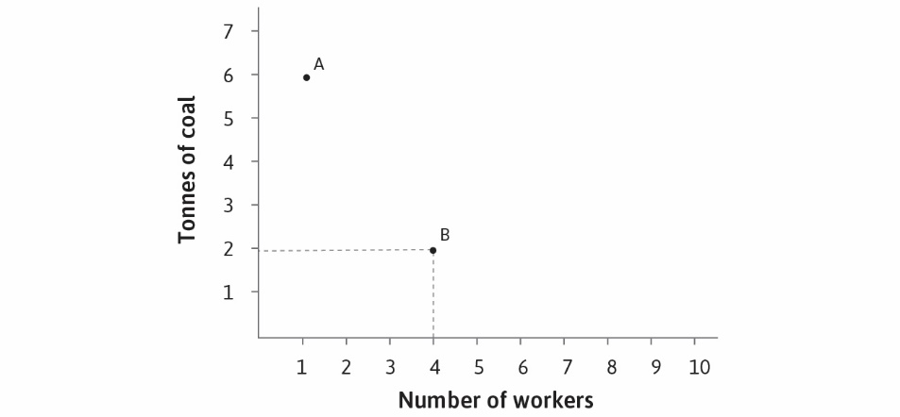

Slide 31
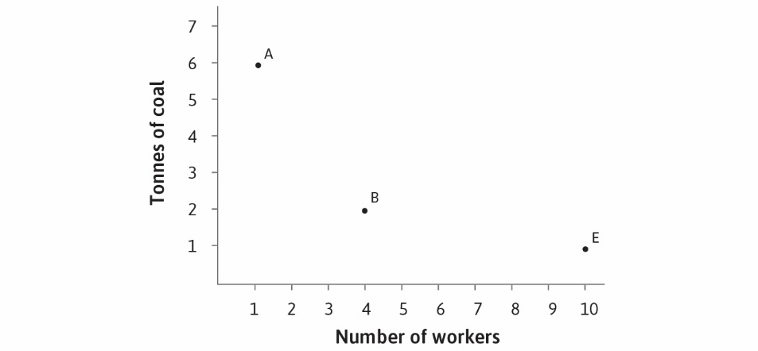

Slide 32
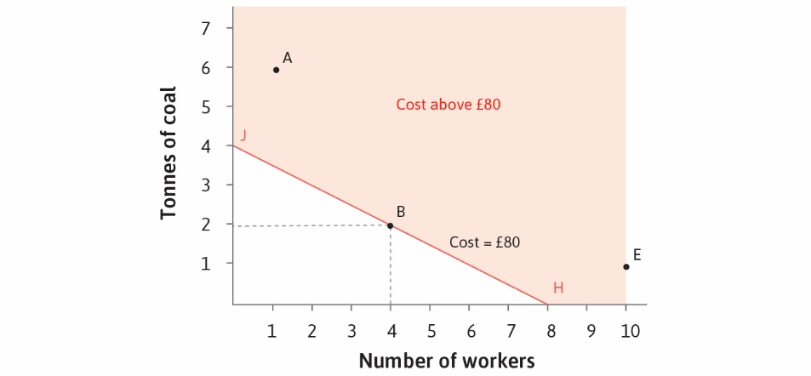

Slide 33
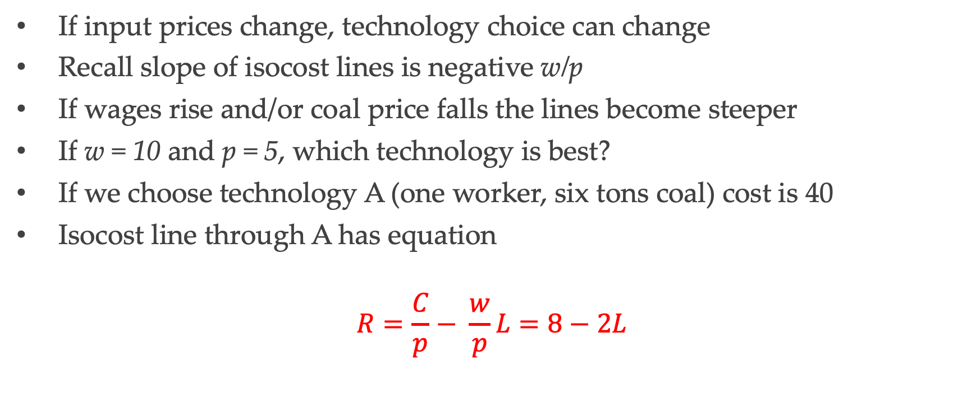
Changes in Input Prices
If input prices change, technology choice can change
Recall slope of isocost lines is negative w/p
If wages rise and/or coal price falls the lines become steeper
If w = 10 and p = 5, which technology is best?
If we choose technology A (one worker, six tons coal) cost is 40
Isocost line through A has equation
$$R=\frac{C}{p}− \frac{w}{p}L=8−2L$$

Slide 34
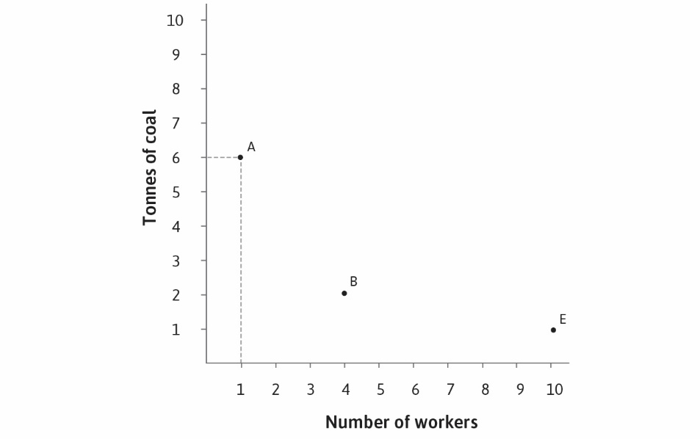

Slide 35
The Industrial Revolution

Slide 36
Back to the Hockey Sticks
Can this help us understand why industrial revolution started in Britain?
Look at wages relative to cost of energy and other capital goods
At initial wages and prices B is best
At higher wages and/or lower energy prices this changes
Labor-saving technology A becomes profitable to develop as wages rise

Slide 37
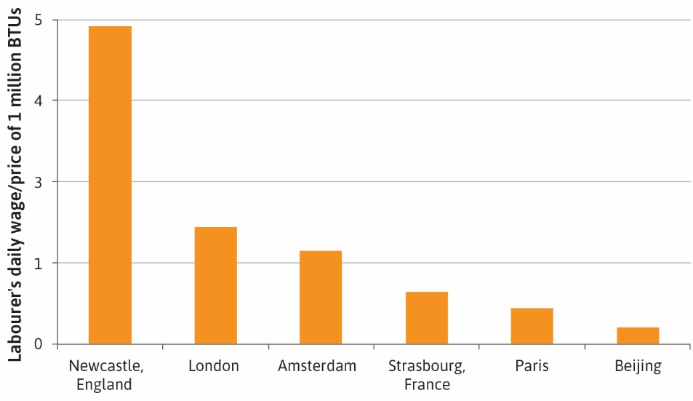

Slide 38
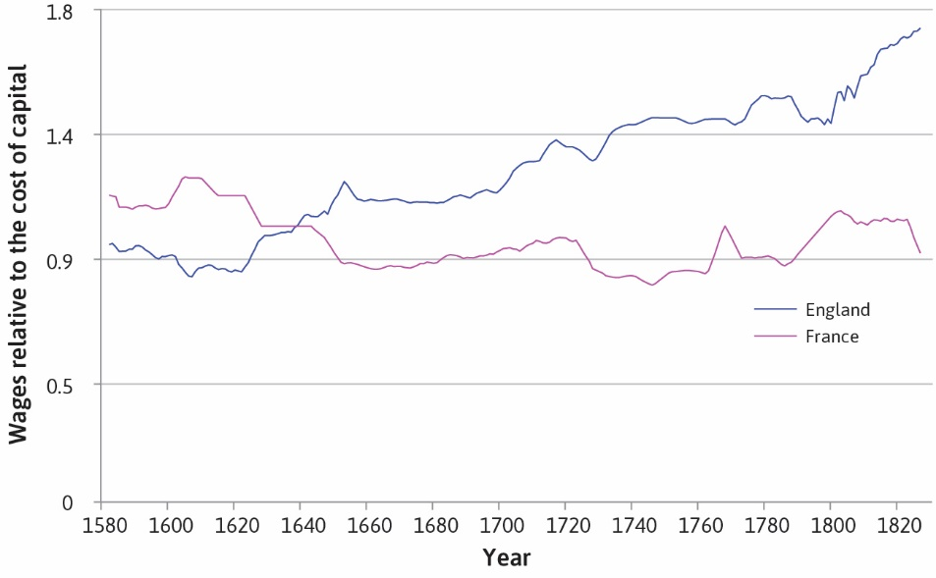

Slide 39
